Slide 1
Описание фотографии на английском языке
Обратите внимание на выделенные слова:
- причинно- следственные союзы придают вашему описанию логичность
- вводные слова придают вашей речи связность и естественность.

Slide 2
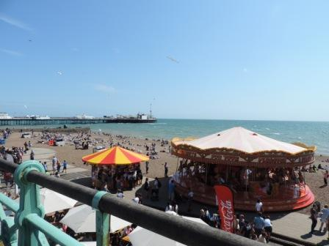
Воспользуемся стандартным способом описания, то есть начнем с общего плана и постепенно будем переходить к частному, а именно, к деталям. Кстати, в конце, обязательно, надо сказать несколько слов о теме фотографии и о своем отношении к данной теме.
Итак, порядок такой:
общее описание того, что вы видите (в данном случае, пляж в курортном городке)
детали (аттракционы, много людей, отличная погода)
ваше отношение к теме ( хотели бы вы оказаться сейчас на пляже? — ответ очевиден!)

Slide 3
Вводная фраза:
Well, I would like to start with a general description.
Что изображено:
This photo (picture) shows a seaside resort in summer. The weather is hot that’s why the beach is full of people.
Детали:
There are no clouds in the sky and it looks light blue. As for the sea, it is a bit rough, I can see the waves, so the light wind is probably blowing.
In the foreground just a bit to the right there is a big merry-go-round. I can guess that a lot of children are riding horses there. They may be laughing, shouting, in other words, they are having fun.

Slide 4
Another kind of attraction is situated to the left of the first one. It looks smaller and at the first sight you can suppose that it is a merry-go-round, too. But if you look closer, you can see that it might be a kiosk with some food or souvenirs because people are standing around probably looking for something to buy.
The beach is very crowded. The people are lying on the sand and swimming in the sea.
Не забудьте о заднем фоне: In the background I can make out the outline of a white pier (пирс) which stands out against the blue sky.
Заключение: As for me, I have enjoyed a lot describing this cheerful picture. This sunny beach makes me feel optimistic because in a few weeks I hope I will be enjoying swimming in the sea, too.

Slide 5
Стандартные фразы и выражения для описания фотографии на английском языке

Slide 6
The photo shows … — На фотографии изображено …
In the centre/middle of the photo we can see a … — В центре/ середине фотографии мы видим …
In the foreground there is a … — На переднем плане находится …
In the background there are … — На заднем плане находится …
It is situated in … — Он расположен в …
On the left (of …) stands … — Слева (от …) стоит …
On the right (of …) sits… — Справа (от…) сидит …
In the distance we can make out the outline of a… — Вдалеке мы можем разглядеть очертания …
At the first glance, … — На первый взгляд, …
But if you look closely, you can see … — Но если присмотреться, вы можете увидеть…
It looks strange … — Он выглядит странно
It looks like …. — Она похожа на …
As for, … — Что касается …

Slide 7
Лексика для описания фотографии на английском языке

Slide 8
I can suppose that … — Я могу предположить, что …
I guess … — Я полагаю …
I can hardly make out (= see) — Я едва могу различить (увидеть) …
It stands out against the blue sky. — Она выделяется на фоне голубого неба.
She looks tired. — Она выглядит уставшей.
It looks as if it is getting dark. — Похоже, начинает темнеть.
They may /might be looking for … — Они, возможно, ищут …
The wind is probably blowing. — Вероятно, дует ветер.
It seems to me that … — Мне кажется, …
the outline of a white pier — очертания белого пирса
Запомните:
in the sky — на небе
in the rain — под дождем (как бы внутри дождя)
in the sun — под солнцем (в солнечном свете)
Также, если вы говорите о том, что изображено НА картине или фотографии, надо употреблять предлог IN:
in the picture
in the photo

Slide 9
Это стандартное описание фотографии, оно избыточное для формата ЕГЭ!
Описание фотографии на ЕГЭ не должно занимать более 2 минут!

Slide 10
Примерное описание фотографии
(ЕГЭ, задание 3)
по опциям

Slide 11
Task 3. Imagine that you are showing your photo album to your friend. Choose one photo to present to your friend. You will have to start speaking in 1.5 minutes and will speak for not more than 2 minutes. You have to talk continuously. In your talk remember to speak about:
(1) when you took the photo — где ты сделал этот снимок
(2) what/who is in the photo — что или кто на фотографии
(3) what is happening — что происходит в момент, когда был сделан снимок
(4) why you took the photo — почему ты сделал этот снимок
(5) why you decided to show the picture to your friend — почему ты решил показать эту фотографию своему другу

Slide 12
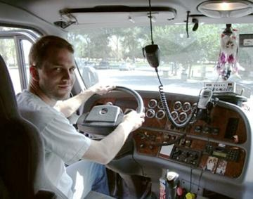
(0) Well, I have chosen to show you photo number 2.
(Это ваша первая фраза. Она нужна для экзаменатора).
Look at this photo.
(Так нужно начать, если вы сдаете экзамен в компьютеризированной форме, без участия экзаменатора-собеседника.)
(1) I took it a month ago when I was going on excursion with my classmates. I remember that day very well.
(2) In this photo you can see our bus driver. As you see, he looks very friendly. We have made friends with him.
(3) We were going to the State Darwin Museum and on the way he told us a lot of facts about wild life. By the way, he is from the northern part of Russia.

Slide 13
(4) Well, at that time I was doing a project on my future profession. That is why I took the photo. I have already had a lot of pictures of different people. And, you know, when I was a boy, I wanted to be a driver, too. So, I decided that it was not a bad idea to use this photo in my project.
(5) The job of a driver seems to me rather boring now but I would like to show the photo to you as he is very well-read and interesting person. Besides, I believe he likes his job. You know, there is a saying «Choose a job you love and you will never have to work a day in your life». (в заключение, вы приводите известное изречение китайского философа Конфуция).

Slide 14
(6) That’s all I wanted to say. (заключительная фраза)
Всего 12-15 фраз. В приведенном выше описании фраз больше, но не надо зацикливаться на количестве фраз. Просто надо уложиться в 2 минуты.

Slide 15
I have chosen photo number three.
I took this photo when I was on holiday last summer /at home one evening some
years ago/while I was walking round a town that I was visiting on holyday/ while my family and I were visiting Greece last summer.
It shows …
I took this photo because I had a great time at the event and I wanted something to remember it by /to remind myself that there are people who… /it was the first time I had ever seen… / I thought it was a really great experience.
I am showing it to you because I want you to see what the event (it) was like / where I spent my holiday /I wanted to show you how interesting …. can be/ I thought it was quite impressive.
It’s one of the best photos I took while I was on holiday.
Maybe we can go there together some time, if you are up for it / if you like such kind of activities too / if I’d like to go back.

Slide 16
Тренируем умение
описывать фото
(ЕГЭ, задание 3)
по опциям

Slide 17
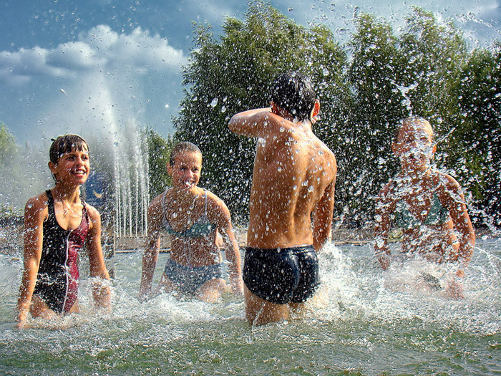
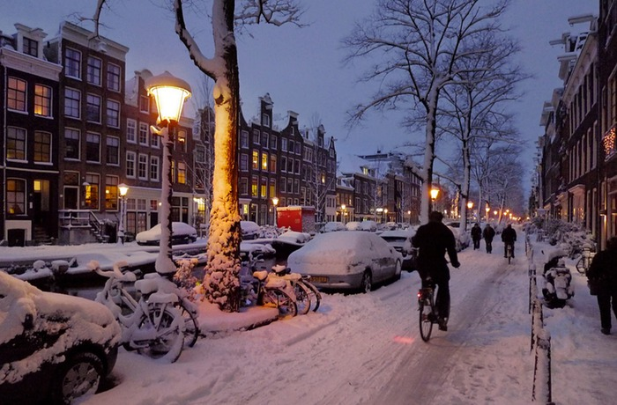
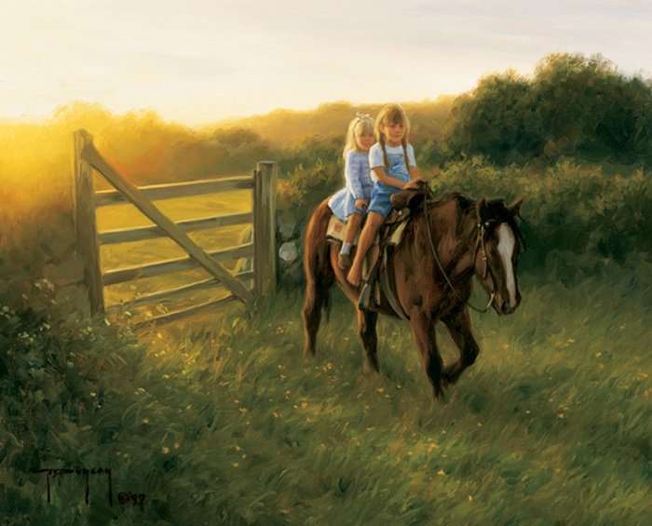
• when you took the photo
• what/who is in the photo
• what is happening
• why you took the photo
• why you decided to show the picture to your friend
Splash each other - брызгаться
Twilight – сумерки, snow-drift – сугроб
Bridle – уздечка, barefooted -босоногая

Slide 18
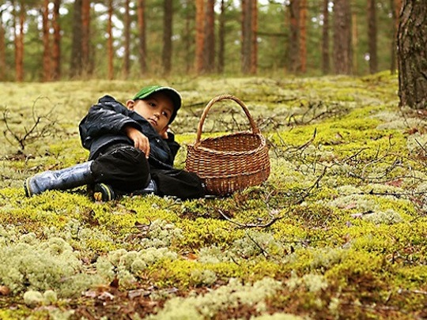
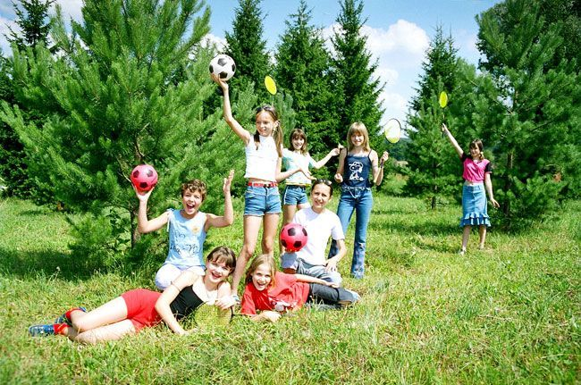
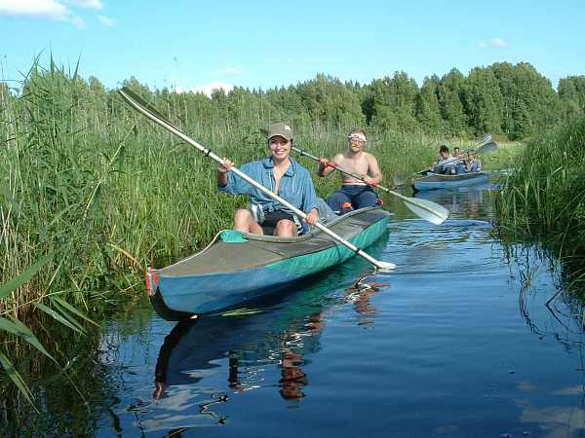
• when you took the photo
• what/who is in the photo
• what is happening
• why you took the photo
• why you decided to show the picture to your friend
Pine-tree – сосна, moss – мох, fir- tree – ель, Oar – весло

Slide 19
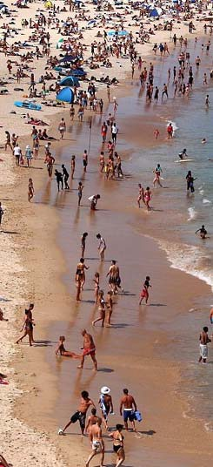
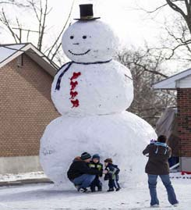
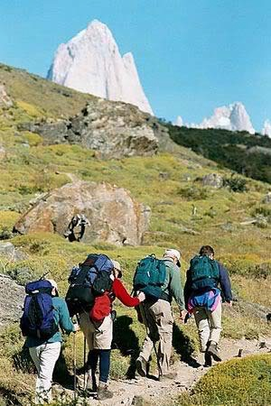
• when you took the photo
• what/who is in the photo
• what is happening
• why you took the photo
• why you decided to show the picture to your friend

Slide 20
Удачи на экзамене!
http://englishinn.ru/ege-po-angliyskomu-yazyiku-ustnaya-chast.html
http://englishinn.ru/opisanie-fotografii-na-angliyskom-yazyike.html

