Slide 1
This Earth was made for you and me
The lesson for 8 form
Bodrova I.V., English teacher

Slide 2

Фонетическая зарядка
Garden Number
Farm Honey
Dark Lunch
Park Custom
Laugh Money
Heart Button

Slide 3
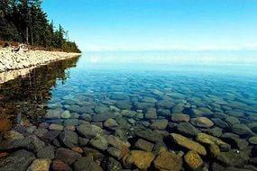
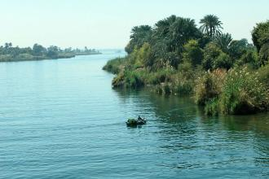
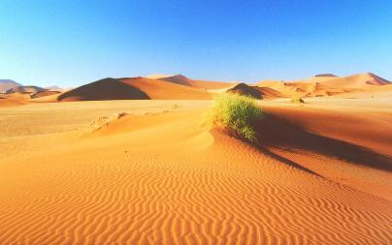
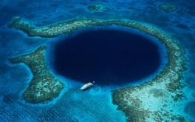
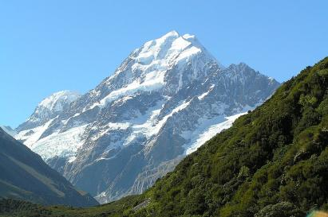
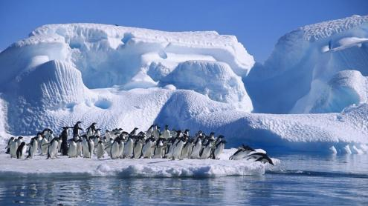
What will we speak about in our lesson?

Slide 4
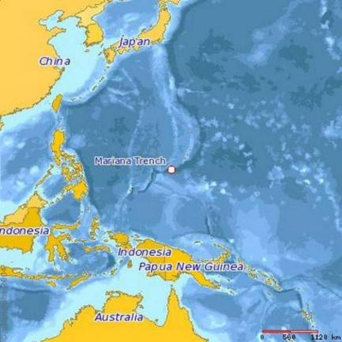
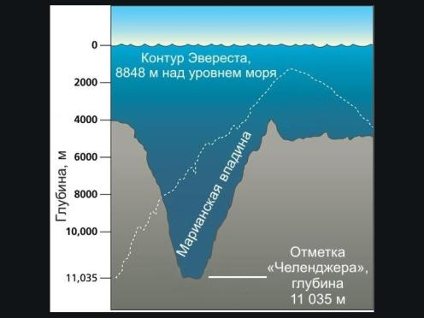

Some information about Challenger Deep

Slide 5

What grammar rule can we remember?
… + er more …..
the …+ est the most ….
Workbook p.20, ex.2

Slide 6

What makes Russia special?
Russia is the largest country in the world.
In Russia there is the deepest lake Baikal,
the largest lake the Caspian Sea,
the coldest place at Vostok base, Antarctica

Slide 7

Grammar focus: review
Past Simple | Past Continuous | Past Perfect
S V2 | S was/were Ving | S had V3
Yesterday A week ago Last year In 1567 | At 5 o’clock yesterday The whole evening When he phoned | By 6 o’clock yesterday By that time Before she came in When he came in

Slide 8

Work in groups
Textbook p.33, ex. 122
Past Simple
Textbook p.33, ex. 123
Past Simple or Past Continuous
Textbook p.33, ex. 124
Past Simple or Past Perfect

Slide 9
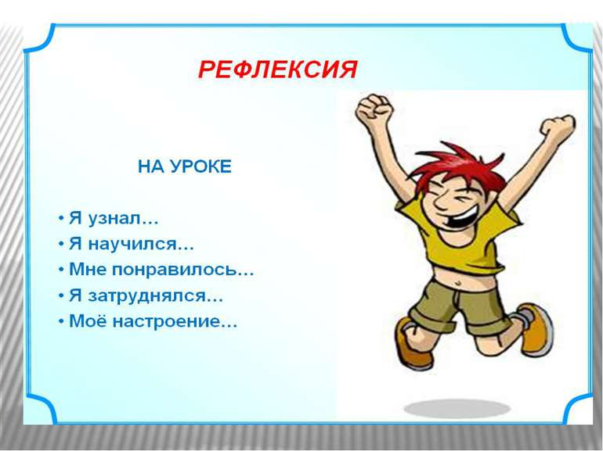

Slide 10
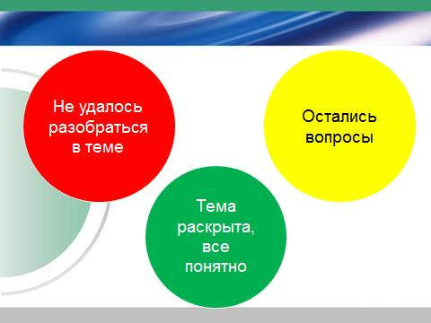
What have you known in our lesson today?

Slide 11

Homework
Textbook p.38, ex. 31*
Workbook p.21, ex. 3, 4

Slide 12

Thank you
for your attention!

