Slide 1
Tour of interesting places of Moscow.
Presentation by Suvorova Anastasia, Nephedova Angelica, Ermolaeva Ann.

Slide 2
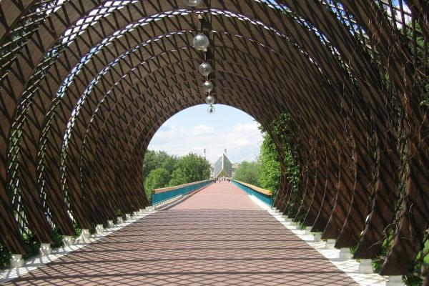
Neskuchny garden is a landscape Park, which has been preserved from a noble mansion called "Neskuchnoye". It is located on the right Bank of the Moscow river and is often seen as part of the Park of culture and rest them. Gorky.

Slide 3
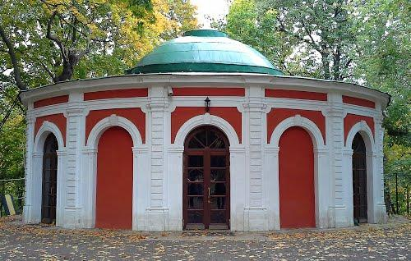
Neskuchny garden – the largest in the capital, the monument of landscape art. Is under state protection. In the garden there are the following Park pavilions:
Hunting Lodge – the rotunda times of the XVIII century. Here are live games "What? Where? When?".

Slide 4
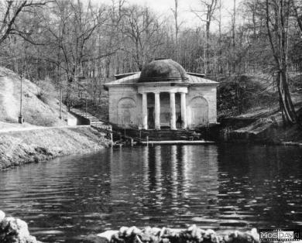
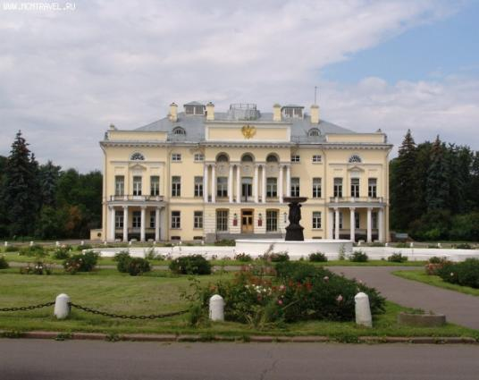
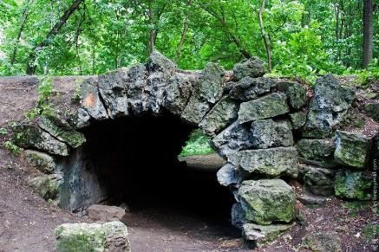
The ensemble at Alexandria Palace with wings and a guardhouse
Bath house with a dome (the end of XVIII century) and the pavilion "Grotto"

Slide 5
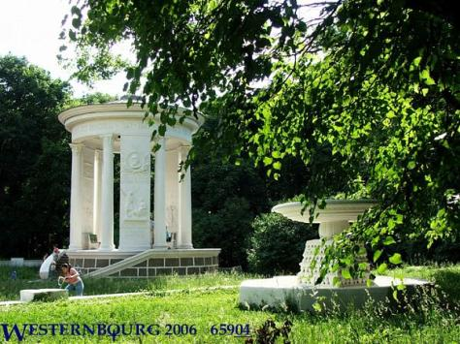
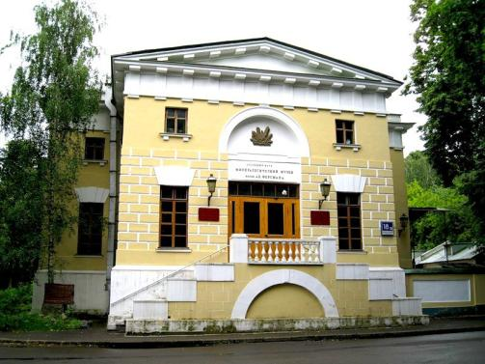
Manege, where is the Mineralogical Museum named after A. E. Fersman.
The rotunda, erected in honor of 800 anniversary of Moscow

Slide 6
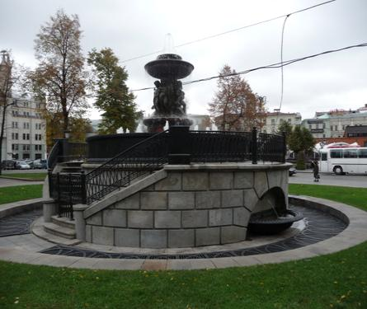
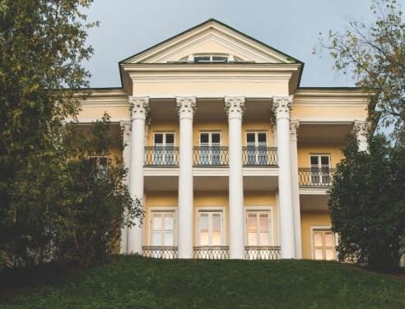
Fountain of Ivan Hovered near the Palace
Summer (tea) house of count Orlov (1804-1806)

Slide 7
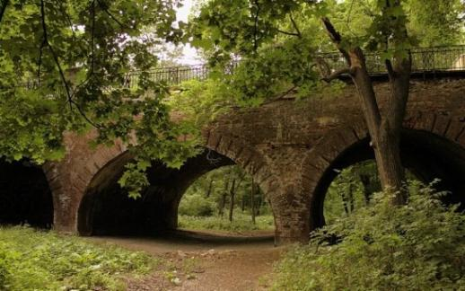
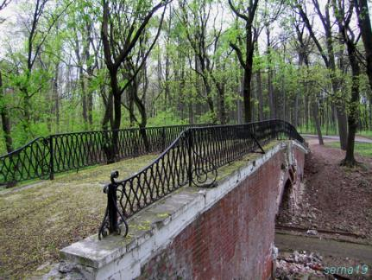
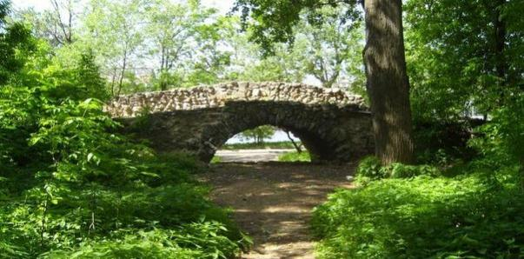
Neskuchny garden is a very pleasant place for a romantic rendezvous, or just walking. It is quiet and cozy. Ideal for fans of quiet rest.

Slide 8
Thank you for your attention!

