Slide 1
food
Made by pupil of from 10
Bodrova Victoria

Slide 2
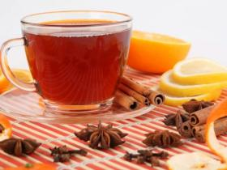
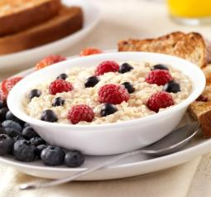
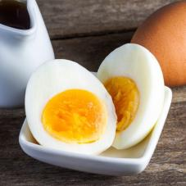
I have breakfast at 8 o`clock in the morning, I often eat porridge with berries or eggs. I also drink green tea with chocolate.

Slide 3
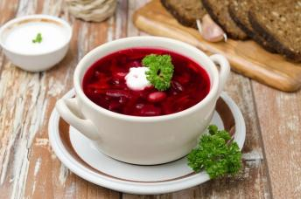
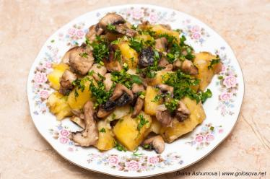
I have lunch at 3pm, I usually eat different soups. When was six I ate potatoes with meat.

Slide 4
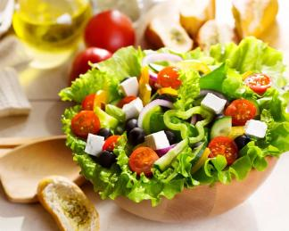
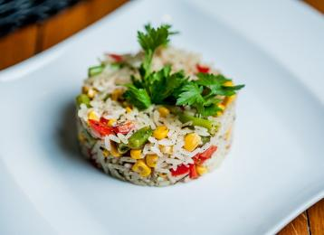
I have dinner at 6pm, I was eating salads or rice with vegetables.

Slide 5
Thank you for listening!

