Slide 1
My favorite food
Made by Timoshenkova E.

Slide 2
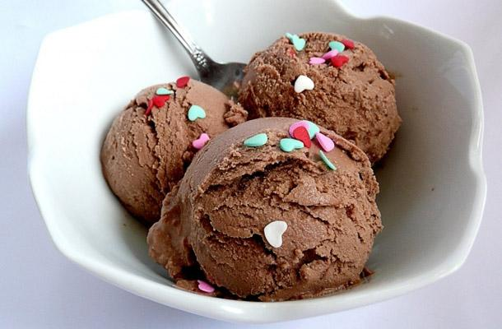
Past Simple
Yesterday I ate a very tasty chocolate ice-cream
I like ice-cream

Slide 3
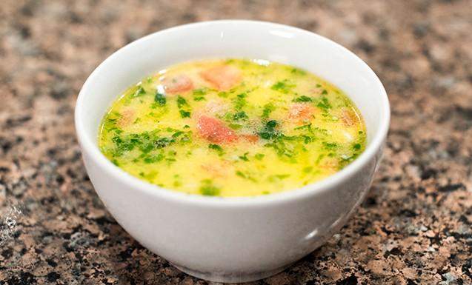
Past Continuous
When I was 6 I loved eating soup
I was eating soup with my friends while my mom was cooking dinner

Slide 4
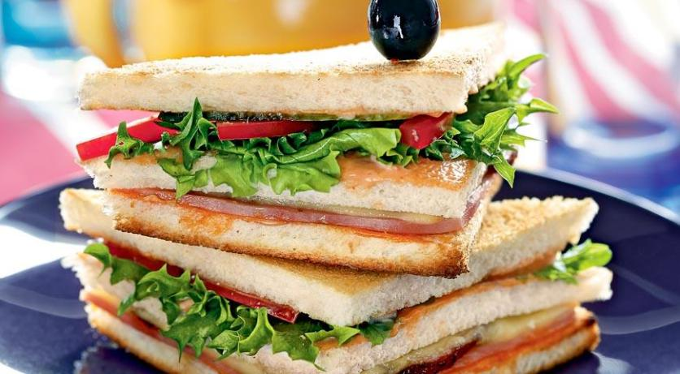
Present Continuous
I am eating a sandwich at the moment
Are you eating this sandwich?

Slide 5
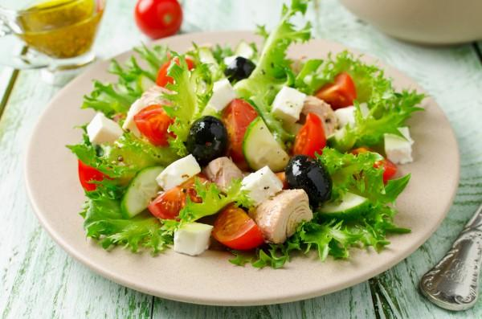
Present Perfect
I have eaten all salad
You haven`t eaten this salad before

Slide 6
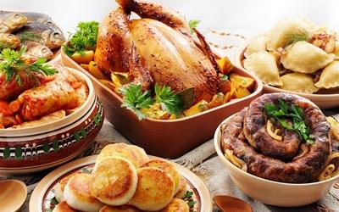
Thanks for watching!
Made by Elizaveta Timoshenkova

